Slide 1
The 80386 microprocessor

Slide 2
80386 Microprocessor is a 32-bit processor that holds the ability to carry out 32-bit operations in one cycle.
It has a data and address bus of 32-bit each.
Thus has the ability to address 4 GB (or 2³²) of physical memory.

Slide 3
Multitasking and protection capability are the two key characteristics of the 80386 microprocessor.
80386 has internal dedicated hardware that permits multitasking.

Slide 4
The 80386 CPU is able to support 16k number of segments and the total virtual memory space is 4 giga bytes x 16k = 64 terrabytes.
Another Features of 80386 Microprocessor has a 16-byte prefetch queue.
It is manufactured by Intel using 0.8-micron CHMOS technology.

Slide 5
It is available with 275k transistors in a 132-Pin PGA package.
It operates at clock speeds of 16 MHz to 33 MHz.
This Features of 80386 Microprocessor has memory management unit with a segmentation unit and a paging Unit.

Slide 7
It operates in real, protected and virtual real mode. The protected mode of 80386 is fully compatible with 80286.
The 80386 instruction set is upward compatible with all its predecessors.

Slide 8
The 80386 can run 8086 applications under a protected mode in its virtual 8086 mode of operation.
The 80386 processor supports Intel 80387 numeric data processor.

Slide 9
Features of 80386
As it is a 32-bit microprocessor. Thus has a 32-bit ALU.
80386 has a data bus of 32-bit.
It holds an address bus of 32 bit.
It supports physical memory addressability of 4 GB and virtual memory addressability of 64 TB.

Slide 10
80386 supports a variety of operating clock frequencies, which are 16 MHz, 20 MHz, 25 MHz, and 33 MHz.
It offers 3 stage pipeline: fetch, decode and execute. As it supports simultaneous fetching, decoding, and execution inside the system.

Slide 11
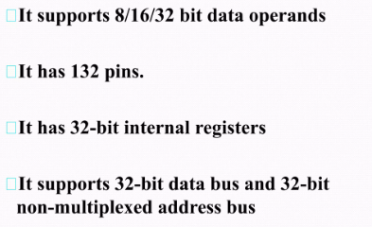

Slide 12
Operating modes of 80386
In the protected mode, 80386 microprocessor operates in a similar way like 80286 but offers higher memory addressing ability.
The other one is the virtual real mode, this mode allows the system to execute multiple programs in the protected memory. And in case a program at a particular memory gets crashed then it will not cause any adverse effect on the other part of the memory.

Slide 13


Slide 14
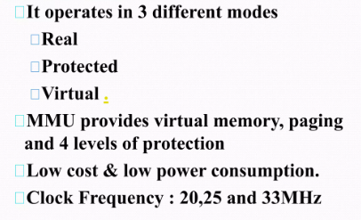

Slide 15
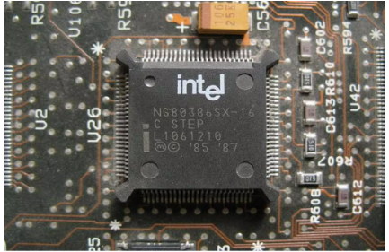

Slide 16
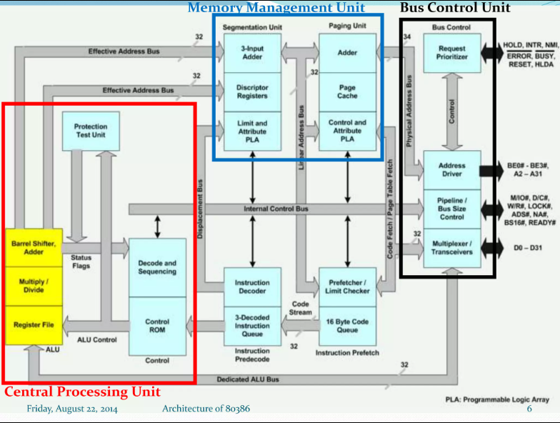

Slide 17
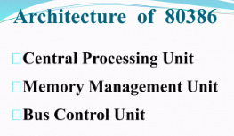

Slide 18
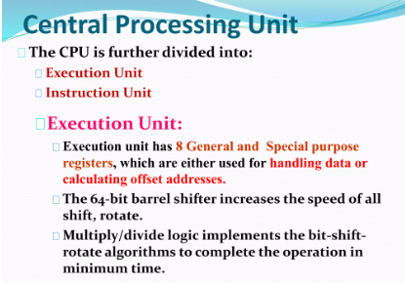

Slide 19
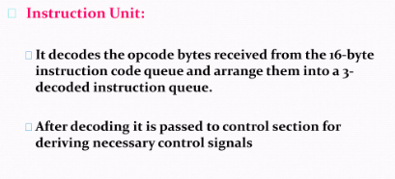

Slide 20


Slide 21


Slide 22


Slide 23
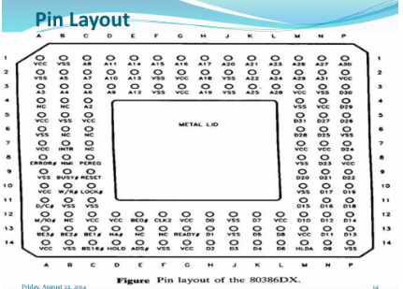

Slide 24
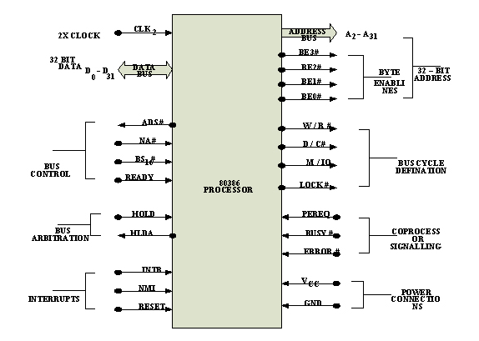

Slide 25
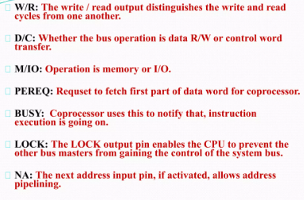

Slide 26
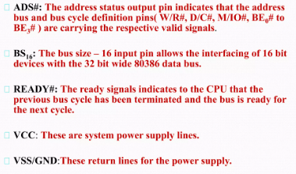

Slide 27
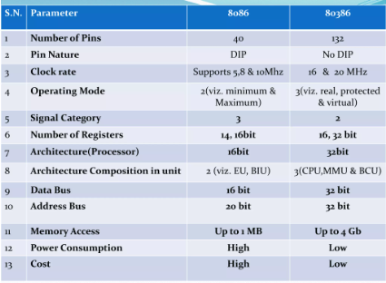

Slide 28
Register Organisation of 80386:
The 80386 has eight 32 - bit general purpose registers which may be used as either 8 bit or 16 bit registers.
•A 32 - bit register known as an extended register, is represented by the register name with prefix E.
•Example : A 32 bit register corresponding to AX is EAX, similarly BX is EBX etc.
•The 16 bit registers BP, SP, SI and DI in 8086 are now available with their extended size of 32 bit and are names as EBP,ESP,ESI and EDI

